Slide 1
QuickBooks Online (QBO) has recently introduced features that specifically tackle this "multiple estimate" headache
Ideas for today and tomorrow

Slide 2
Agenda
QBO overview
Grouping Estimates by Project Phases
The "Multiple Versions" Workflow
Deposits Directly from Estimates Summary
Pro Tip for Your Workflow

Slide 3

As a fellow business owner, I know that for service industries—whether you’re in landscaping, HVAC, or high-end consulting—the "estimate dance" can be the most time-consuming part of the week. You send a quote, the client wants a different version, you send another, and suddenly your "Billing and Payments" tab is a cluttered mess of "what-ifs." QuickBooks Online (QBO) has recently introduced features that specifically tackle this "multiple estimate" headache. Here is how these new tools can streamline your workflow and help you get to "Yes" faster.
“multiple estimate" headache”

Slide 4
Grouping Estimates by Project Phases
One of the most powerful updates is the ability to group line items by Project Phases directly on your estimates. Instead of sending three different emails for "Demo," "Foundation," and "Framing," you can now organize one master estimate into clear stages.

Slide 5
Grouping Estimates by Project Phases
Why it matters: It stops the "sticker shock" of a large total by breaking it into manageable milestones.
The "Multiple" Factor: You can create multiple "Project Estimates" within a single project, allowing you to track various scopes of work in one place without losing the history of previous versions.

Slide 6
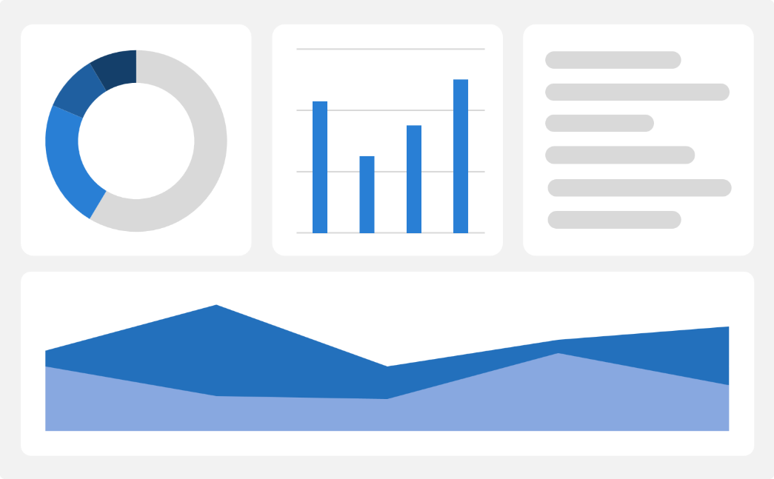
The "Multiple Versions" Workflow
Small businesses often have to provide "Good, Better, Best" options.
While QBO still treats these as separate estimate entries, the new interface in the Billing and Payments section makes managing them much easier:

Slide 7
The "Multiple Versions" Workflow
Duplicate and Revise: You can now quickly duplicate an existing estimate to create a "Version B" without re-typing every line item.
Inactive Status: Once a client chooses one option, you can mark the other outdated estimates as Inactive. This keeps your pipeline clean and ensures you don't accidentally invoice for a rejected quote.

Slide 8

Deposits Directly from Estimates

Slide 9
This is a game-changer for industries that require a down payment to get on the schedule. You can now enable deposits directly on the estimate.
Expand
Foster collaborative growth
Enhance
Ensure a tailored and user-focused experience
Explore
Capitalize on serving more markets
How it works: When the client views the estimate online, they can pay the deposit immediately via credit card or ACH.
Benefit: It secures your cash flow before you even pick up a tool or buy materials.

Slide 10
Progress Invoicing: Convert Parts of Estimates
If you are sending many estimates weekly, you likely aren't billing 100% upfront.
The Progress Invoicing feature (found under Account Settings > Sales) allows you to convert specific percentages or phases of an estimate into an invoice.
This ensures that even if you have "multiple" active estimates for a single client, you are only billing for the work that is completed.

Slide 11
Summary
Pro Tip for Your Workflow
Don't let data clutter slow you down. As we discussed in our guide to Custom Dashboards, keep an "Accounts Receivable" or "Estimate Status" widget on your QBO dashboard. This lets you see exactly how many thousands of dollars are sitting in "Pending" status across those multiple estimates at a single glance.
Need help setting up these features? Managing multiple estimates can get tricky as you scale. If you're spending more time in the "Billing and Payments" tab than you are on the job site, visit us at Dunlap-bookkeeping.com to see how we can help you automate your back office.

Slide 12
Thank you
Theresa Dunlap
832-517-2929
info@dunlapbookkeeping.com
www.Dunlap-bookkeeping.com

