Slide 1
What is a Custom Dashboard?
Quick Guide by Dunlap Bookkeeping

Slide 2
Customized QuickBooks Dashboard:
A custom dashboard is a personalized, "at-a-glance" financial overview screen within QuickBooks Online. Instead of digging through complex spreadsheets or running manual reports every morning, a custom dashboard uses widgets—small, visual charts and graphs—to show you exactly what matters most to your specific business.

Slide 3
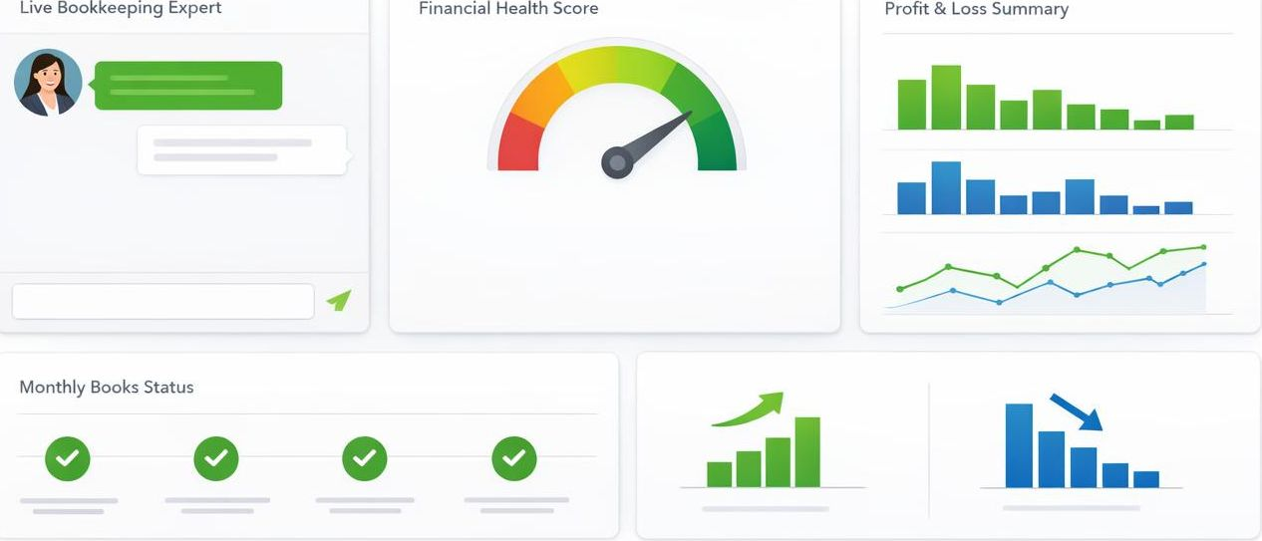
The Cockpit for Your Data
Think of it as the cockpit of your business: you choose which “gauges” to put front and center.
QBO also offers pre-built dashboards for Profitability, Cash Flow, Accounts Receivable, Accounts Payable, Revenue, and more—giving you a head start before you customize.

Slide 4
Why Small Businesses Love Them
1 | Faster Decision-Making: Stop guessing if you can afford a new hire or piece of equipment. See your available funds and trends instantly.
2 | Improved Visibility: Monitor "hidden" patterns, such as seasonal revenue dips or high-spending categories, before they become problems.
3 | Time Savings: Eliminate the need to manually generate the same three reports every Monday.
4 | Personalization: Every business is different. A retail shop might want to see Sales by Product, while a consulting firm might focus on Accounts Receivable.

Slide 5
Essential "Widgets" for Your Dashboard
When setting up your dashboard, we recommend including these key metrics:
Metric | Why It Matters
Profit & Loss | A quick snapshot of whether you are making or losing money this month.
Bank Balances | View all your connected account totals in one spot to monitor liquidity.
Accounts Receivable | Track who owes you money and identify overdue payments instantly.
Expense Tracker | Visualize where your money is going to keep overhead under control.
Sales Overview | See your revenue streams in real-time to track growth.

Slide 6
Quick Setup Tips
Prioritize: Only display the 4–6 most relevant widgets to avoid “data clutter.”
Drag-and-Drop: Click the customize icon (slider icon), then drag and drop widgets so your most important data sits at the top.
Adjust the Date Range: Most widgets let you toggle between “This Month,” “This Quarter,” or “Year to Date” for different perspectives.
Keep it Fresh: Review your dashboard layout monthly. Use the privacy toggle (eyeball icon) to hide financial data when others are nearby.
Note for Advanced Users: If you use QuickBooks Online Advanced, you get access to a KPI Scorecard with 10 standard KPIs. Intuit Enterprise Suite users get 48+ KPIs covering growth, profitability, liquidity, and efficiency.

Slide 7
Need help building a dashboard that actually makes sense for your business?
We’re here to help you move beyond basic bookkeeping. Visit us at Dunlap-bookkeeping.com to learn more!

